Slide 1
FYP presentation
Trajectory Optimisation for Target-in-range problems
Nikilesh Ramesh
16/05/2024

Slide 2
Overview
Motivation
Background
Formulation
Demonstration
Conclusion

Slide 3
Motivation

Slide 4
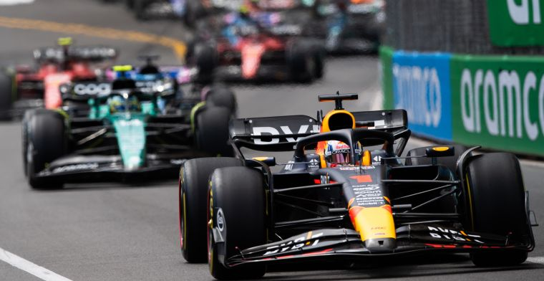
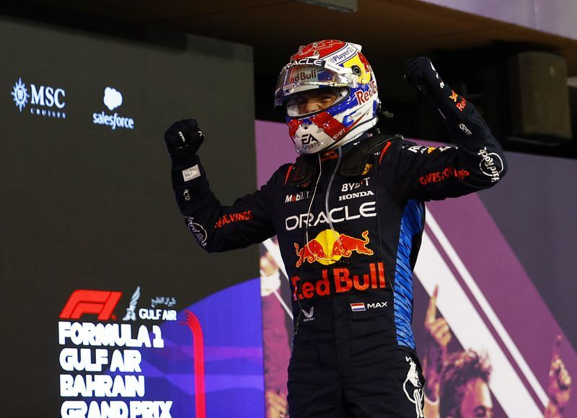
Motivation: Case Study (I)
Consider the case where a F1 race is being tracked with a single autonomous drone.
How do you choose the setpoint for tracking?
Do you choose the car in the mean position? No, fans more care about the winner.
So do you choose the car in the first position? Could do, but what if you got Max Verstappen in a RedBull car with a 20 second lead.

Slide 5
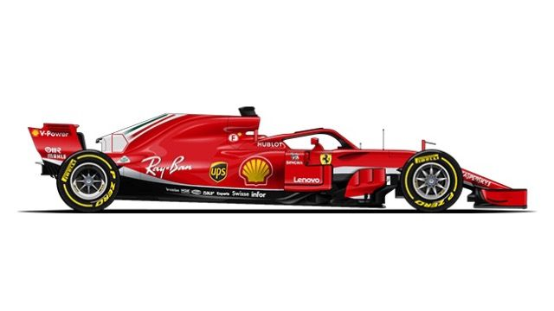
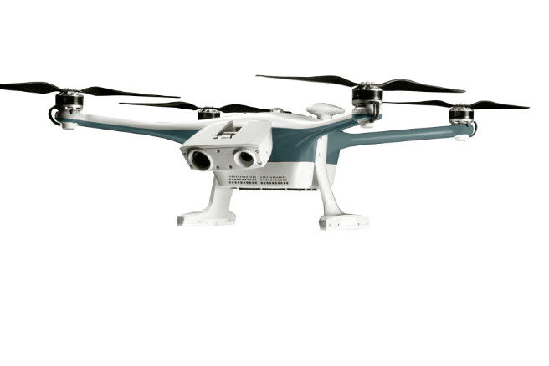
Motivation: Case Study (II)

Slide 6
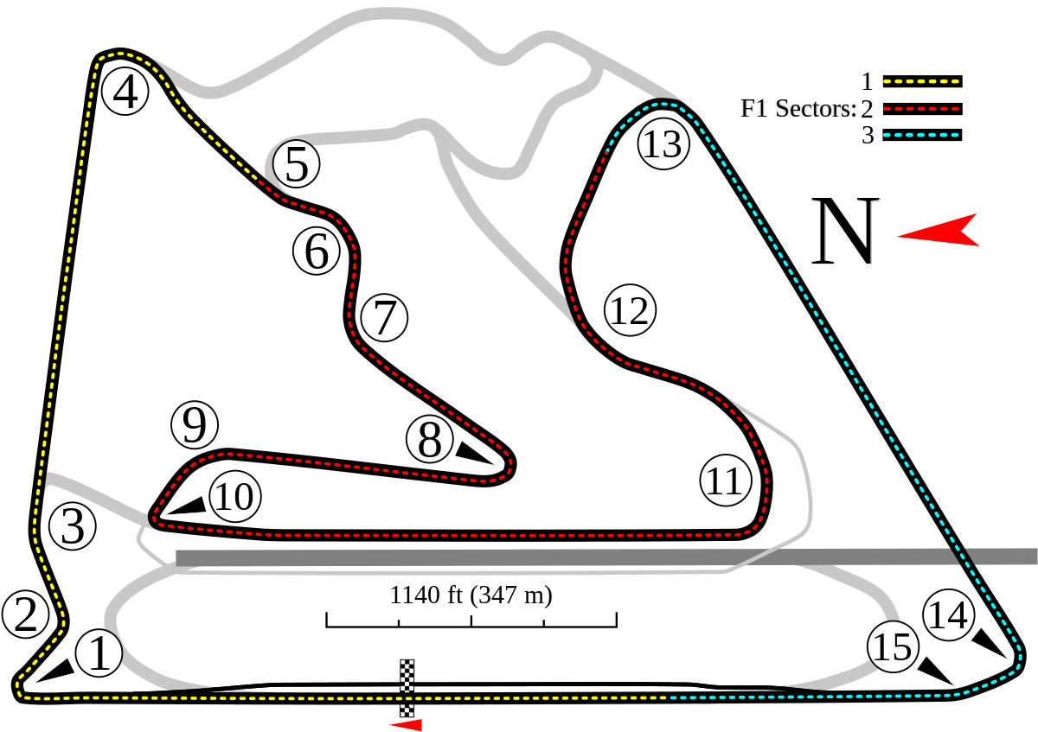
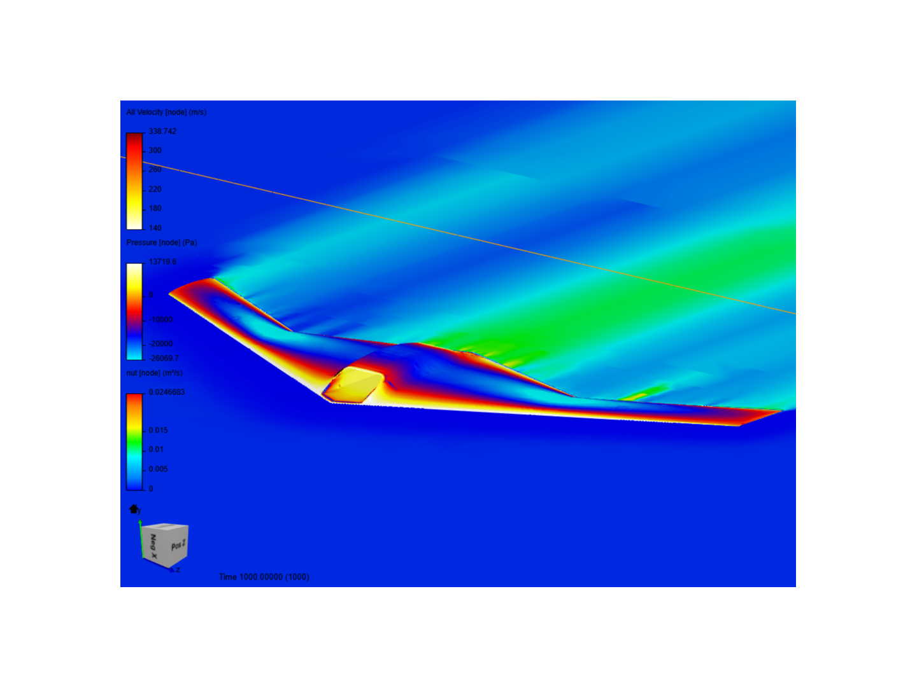
Motivation: Case Study (III)
Map of Bahrain GP.
Efficiency and Entertainment value vs tracking behavior.
UAV can explore more efficient paths if not constrained by the tracking behavior.
NOTE: The most efficient path between two points may not be a straight line cause of physics of the tracker.

Slide 7
Background

Slide 8
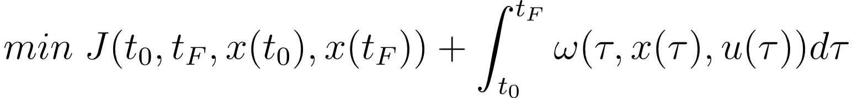
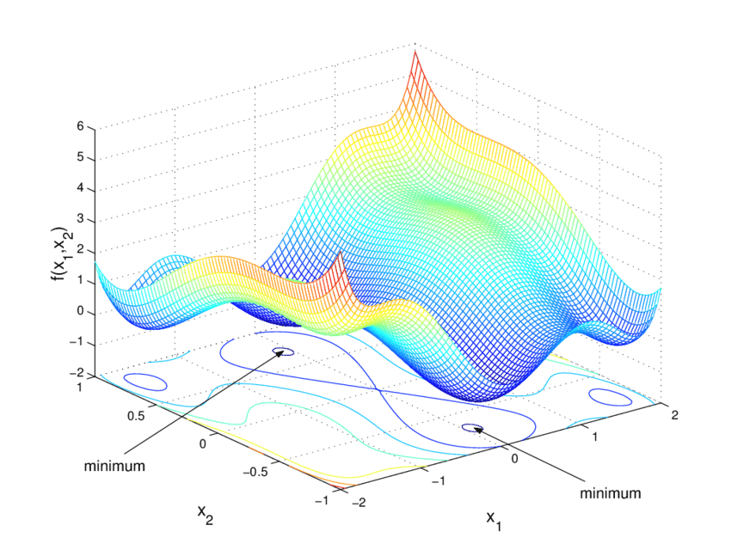
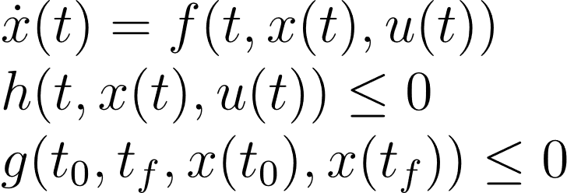
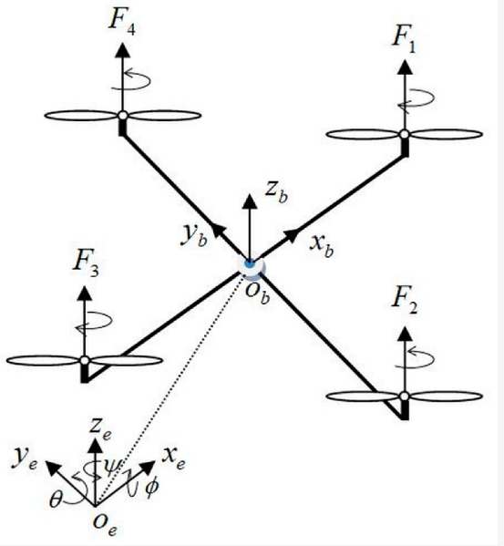
Background (I): Optimal Control Problem
OCPs are posed to find the optimal control input trajectory to minimise an objective function subject to dynamics and mission constraints
Cost
Constraints

Slide 9
Formulation

Slide 10
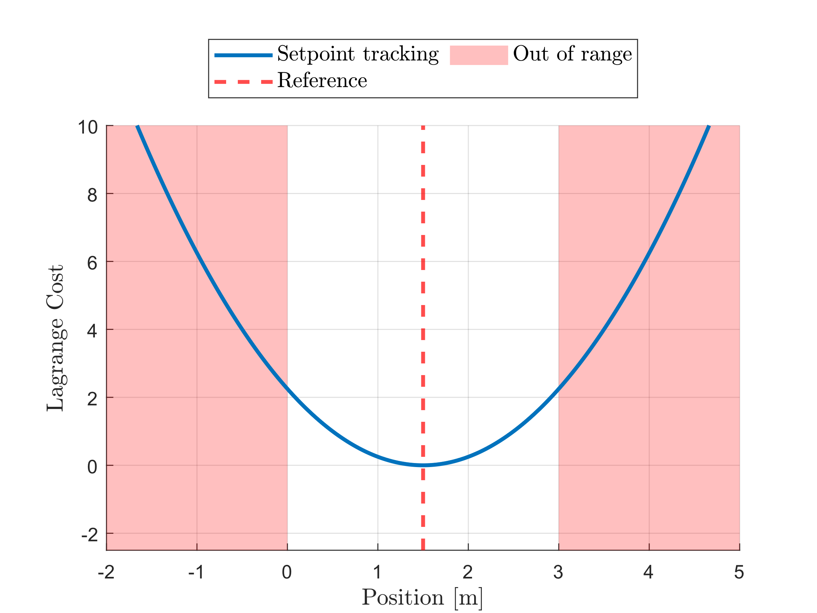
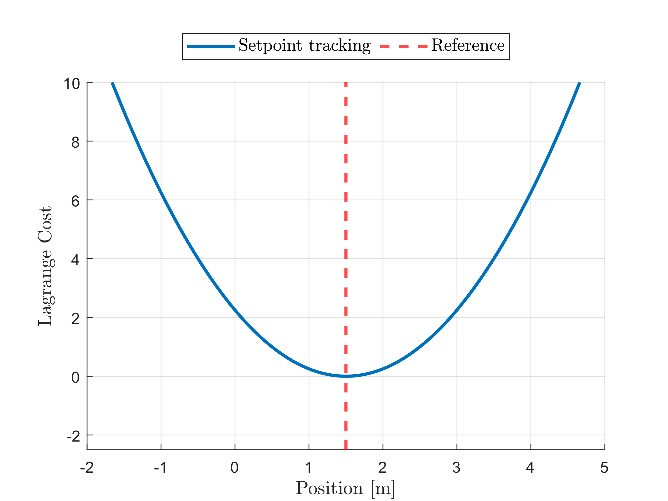
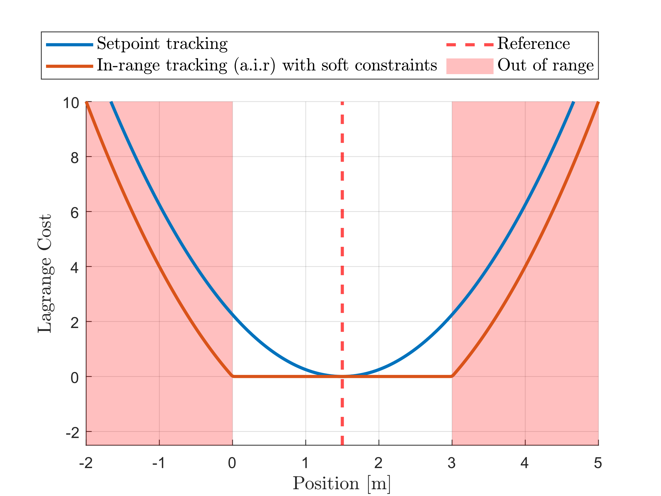
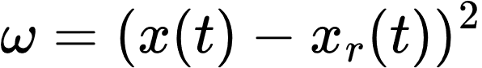
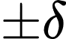
Formulation (I): In-range Behavior
Setpoint Tracking Lagrange Cost
Introduce the range
Always In-range Tracking Lagrange Cost

Slide 11
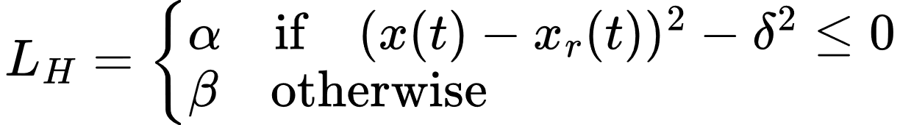
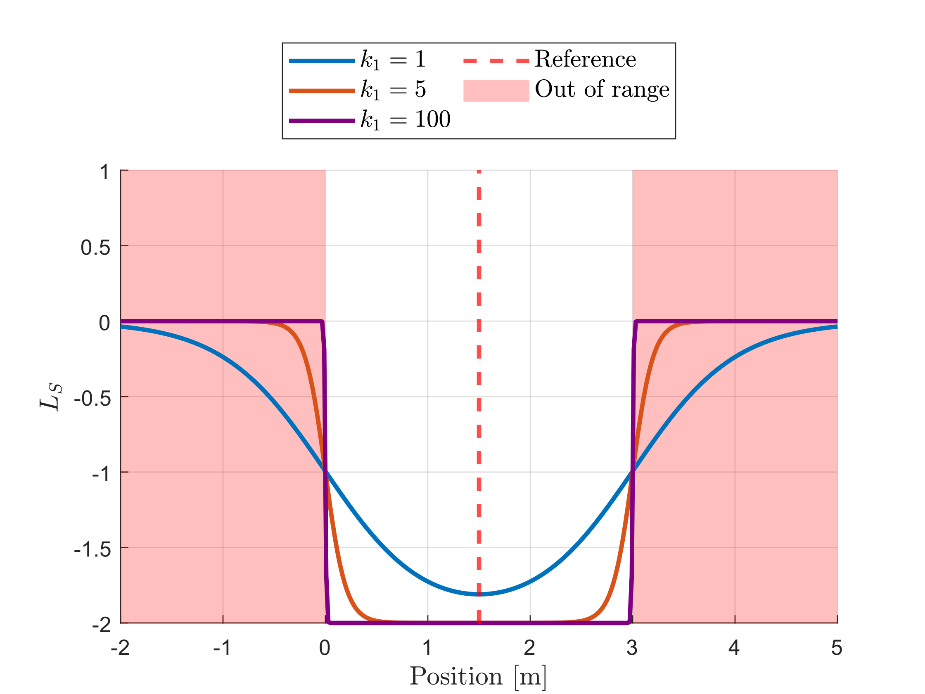
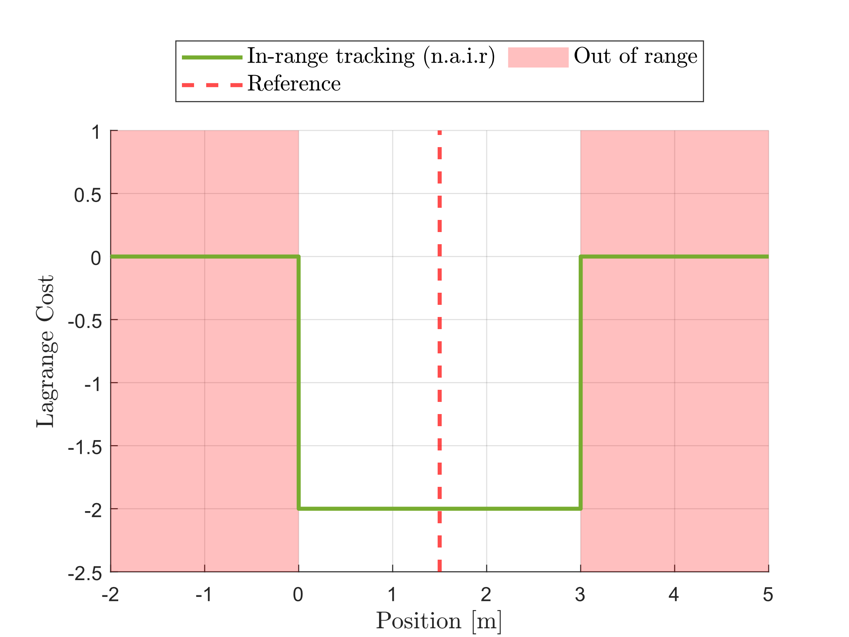
Formulation (II): Out-of-range Behavior
Ideal cost function
Approximate cost function

Slide 12
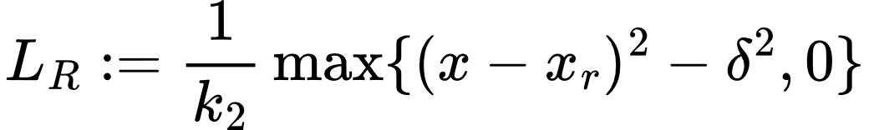
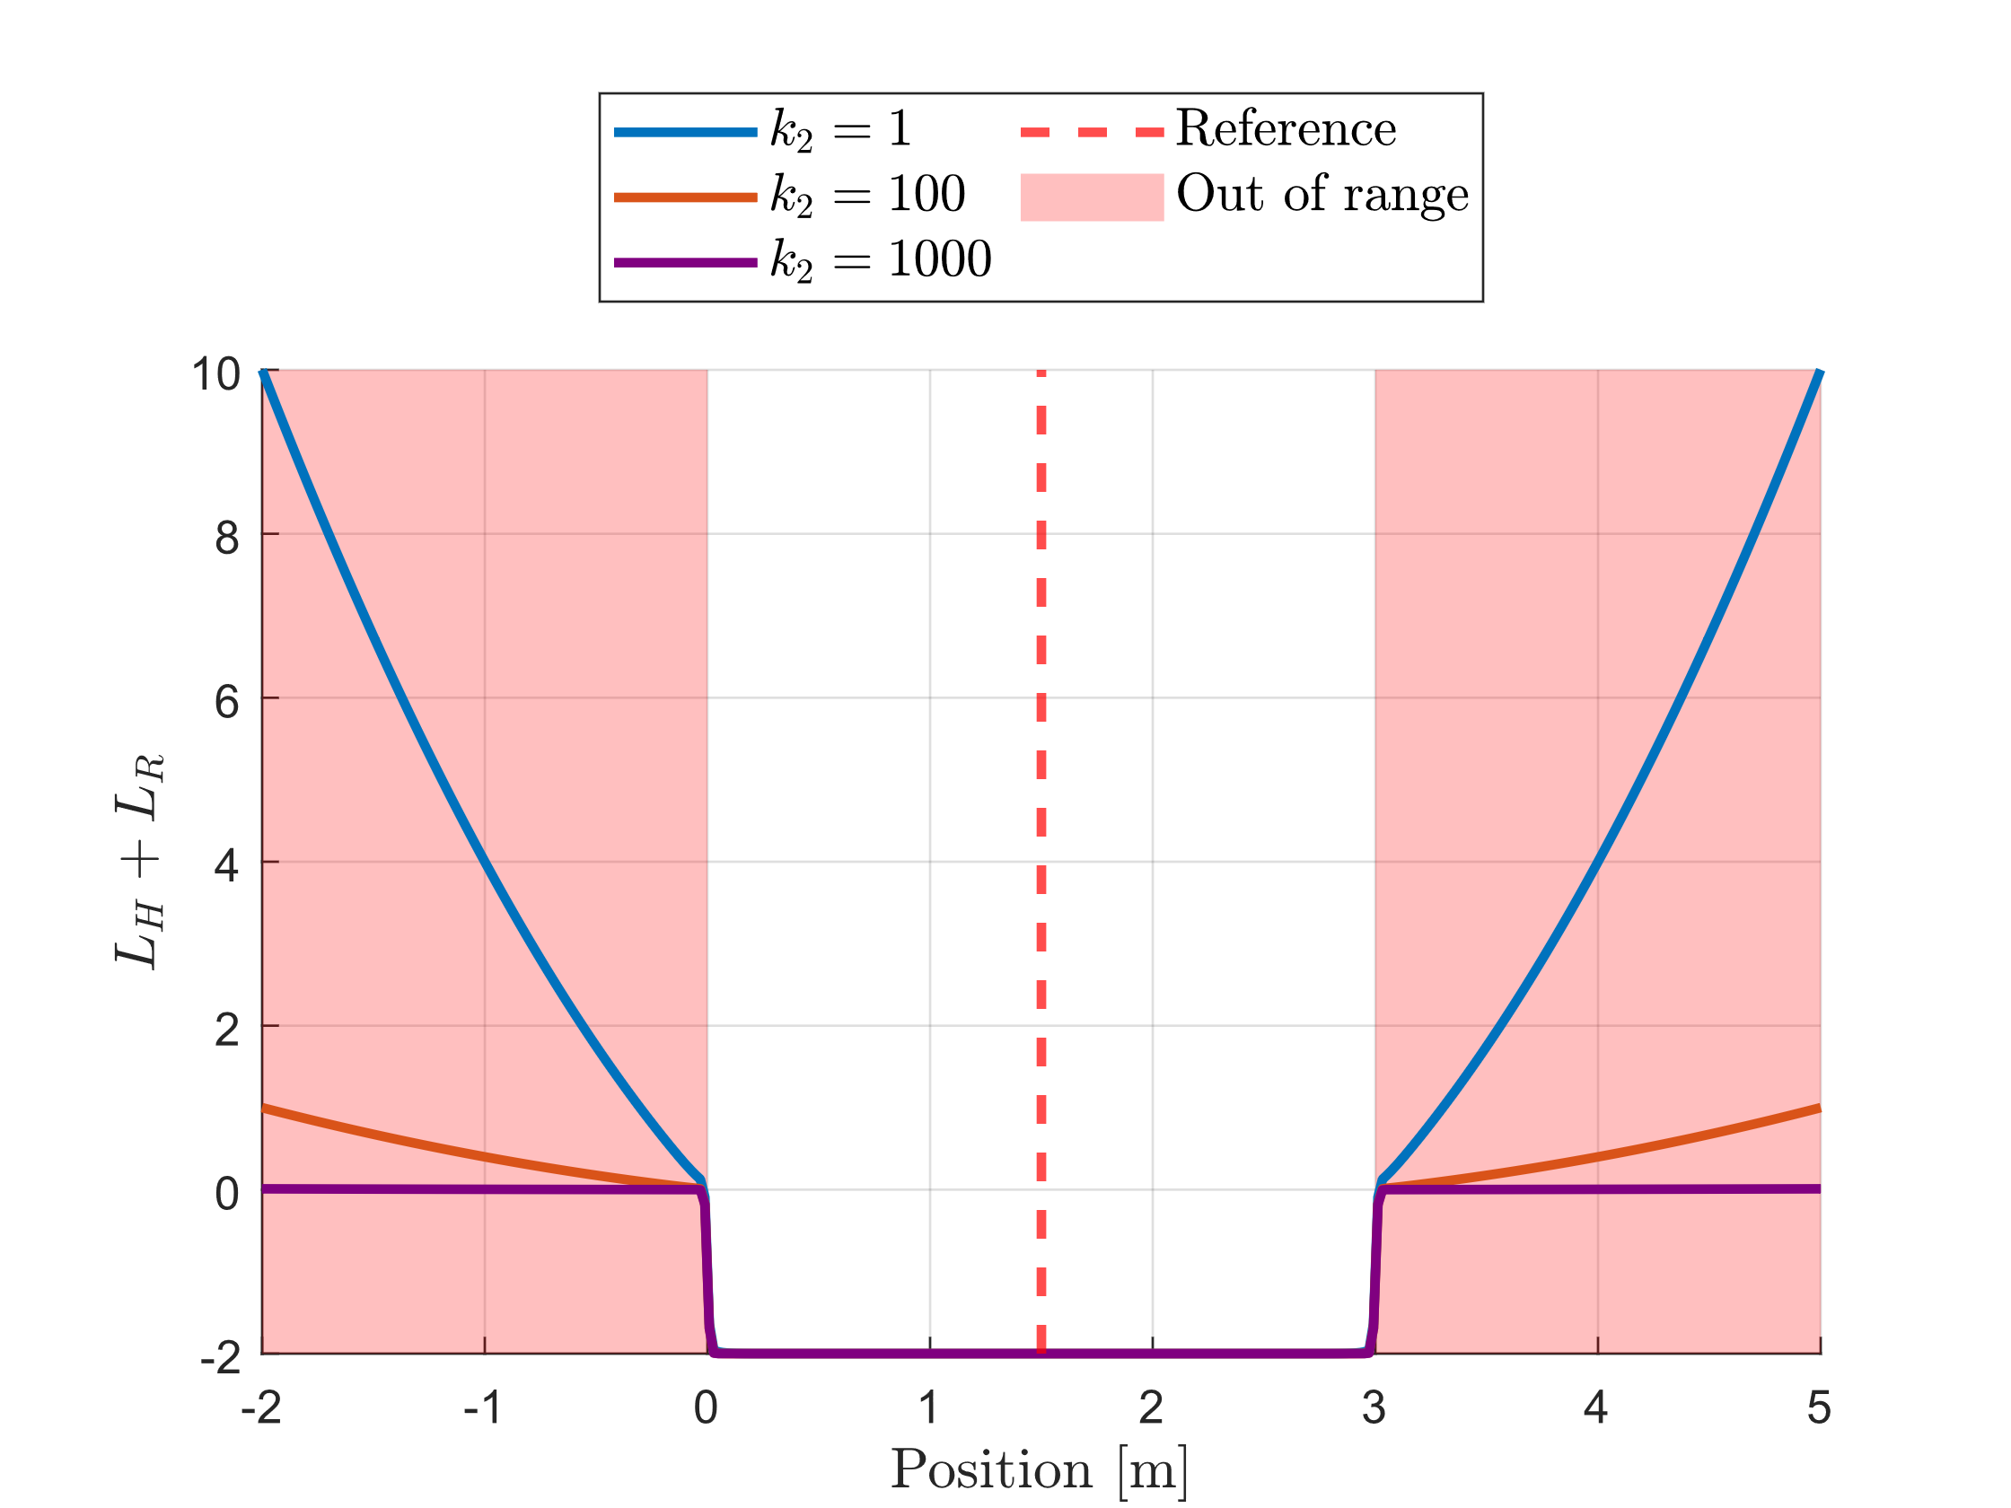
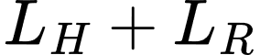
Formulation (III): Regularisation
Introducing regularisation to deal with the lack of gradient information when the tracker out of range.
Small enough to have minimal effects on the overall framework.
After regularisation

Slide 13
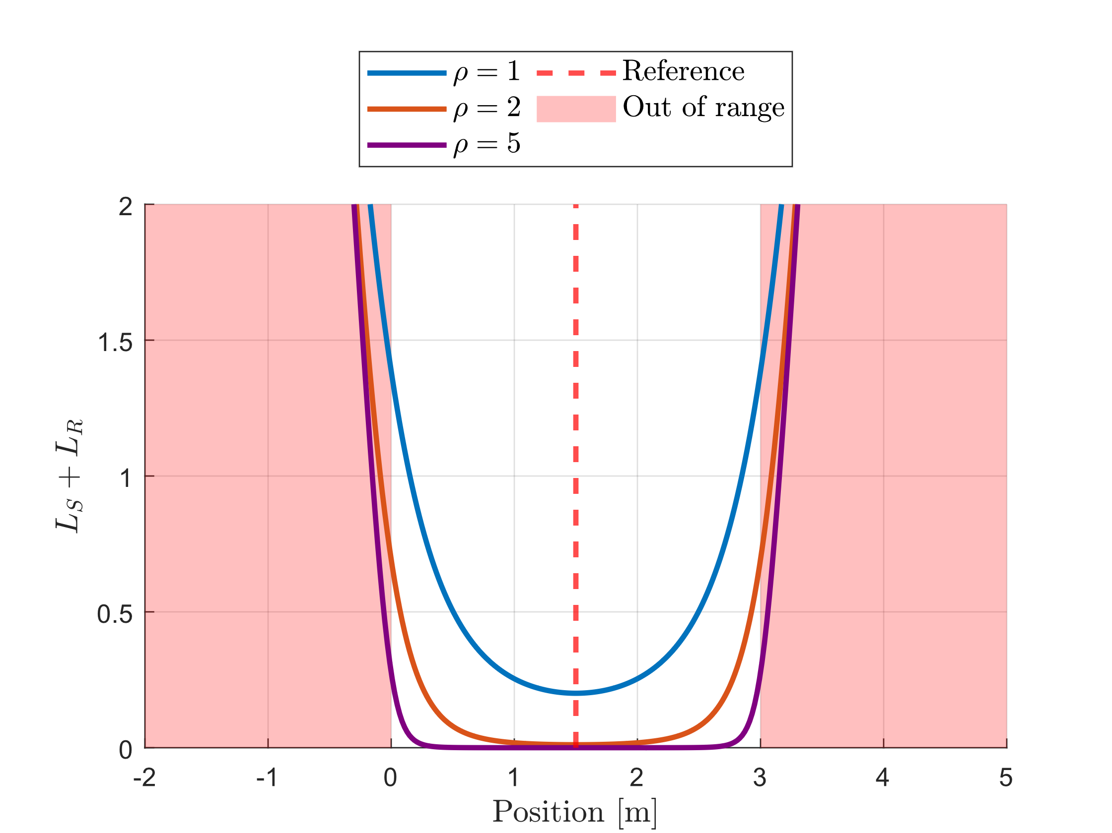
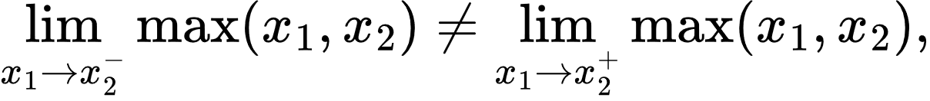
Formulation (IV): Smooth Maximum
Maximum operator is discontinuous
Log-Sum-Exp Function to approximate the maximum operator
Such that

Slide 14
Demonstraition

Slide 15
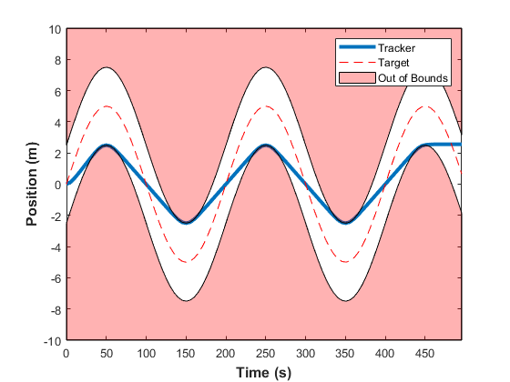
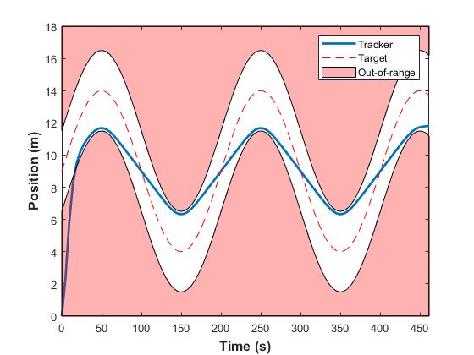
Demonstration (I): Always-in-range
Always-in-range tracking with double integrator dynamics
A.I.R. Tracking with Hard constraints
A.I.R. Tracking with Soft constraints

Slide 16
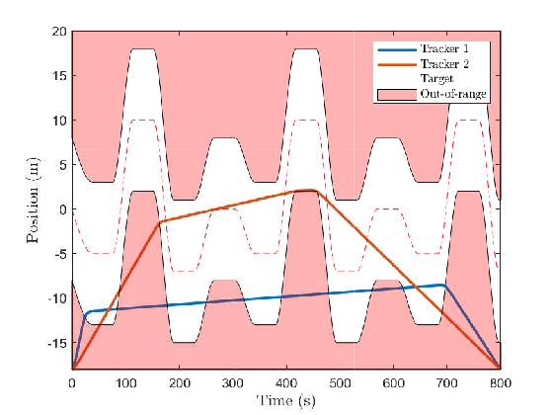
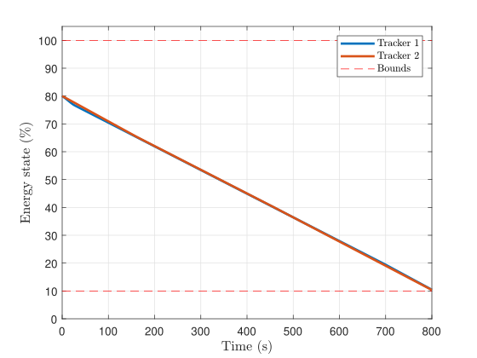
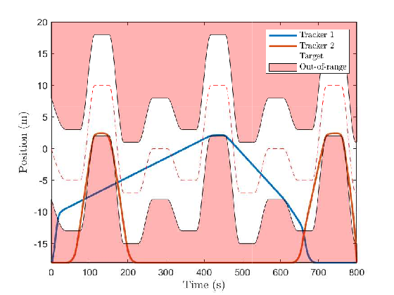
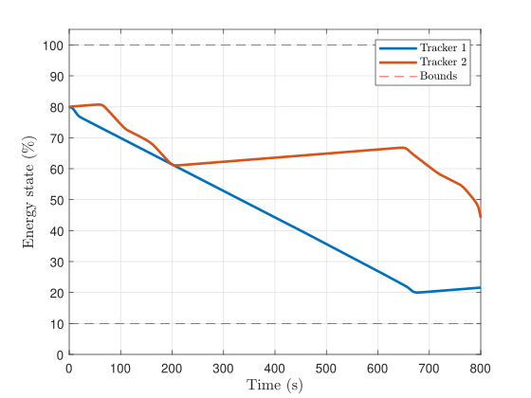
Demonstration (II): Multiagent
Double trackers
Fixed terminal time
Optimised for energy
Simple energy model
Double trackers
Fixed terminal time
Optimised for energy
Energy model with wireless charging

Slide 17
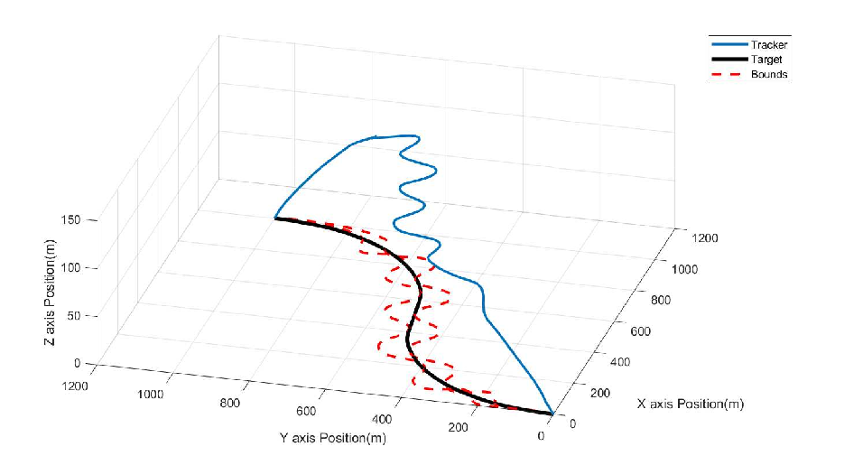
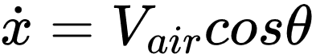
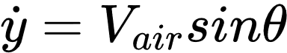
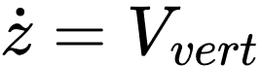
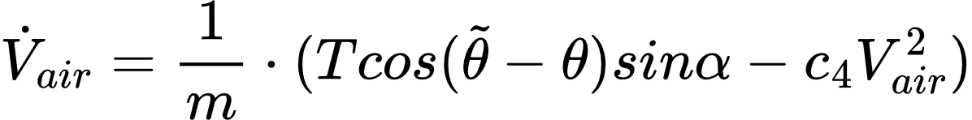
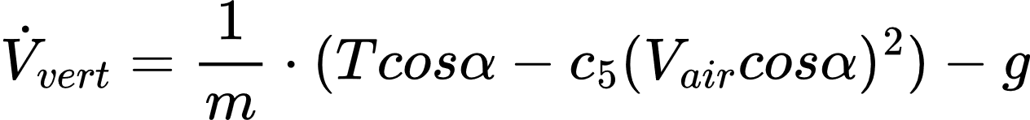
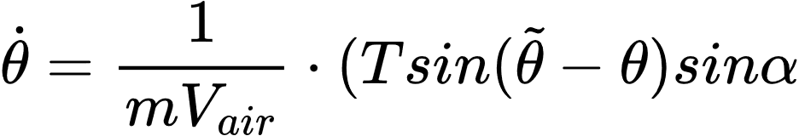
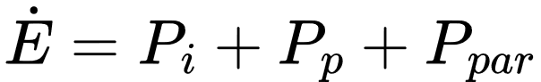
Demonstration (III): Higher Dimensions
Always-in-range tracking with fixed wing UAV in 3D
Range based on the height of drone
Dynamics given below

Slide 18
Conclusion

Slide 19
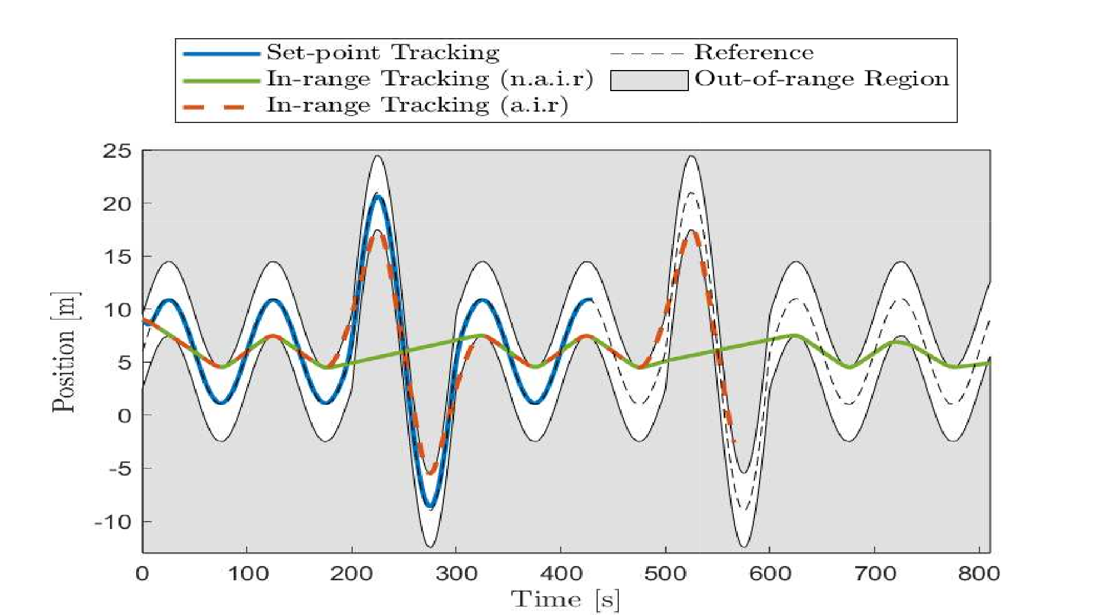
Conclusion
The project objective to present a framework for in-range tracking was successfully completed
In-range tracking can be a better paradigm for tracking compared to set point for suitable problems especially when there are multiple objectives along with the primary tracking objective.
Common problems that could benefit from this paradigms are the problems most concerned with efficiency of tracking and this is handled better by in-range tracking as demonstrated.

Slide 20
Any questions?
Joe.bloggs@Sheffield.ac.uk

